Slide 1

Forests 2020:
Canopy cover estimation based on Support Vector Regression derived from LiDAR & Landsat 8 OLI
Sahid Hudjimartsu, Felliks F Tampinongkol, Yudi Setiawan, Lilik Budi Prasetyo

Slide 2
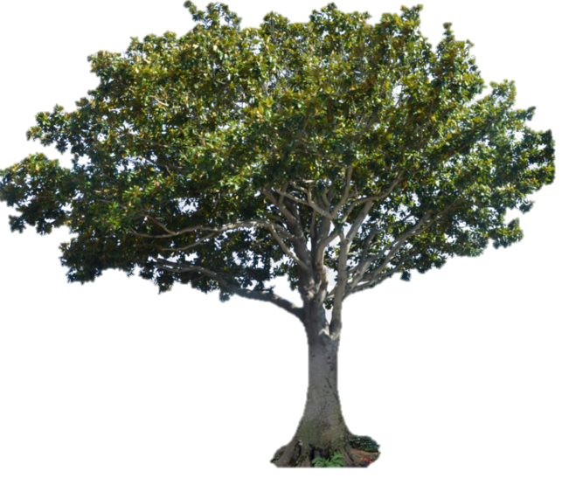



Canopy Cover:
Canopy cover is defined as the percentage of an area occupied by the vertical projection of tree crowns

Slide 3
Indonesian Forests:
Indonesia has many types of forest ecosystem
Ex: peat, swamp, mangrove, tropical rain
This will be a problem in the construction function for National scale using a statistical method, due to many ecosystems and then will have many functions for each ecosystem

Slide 4
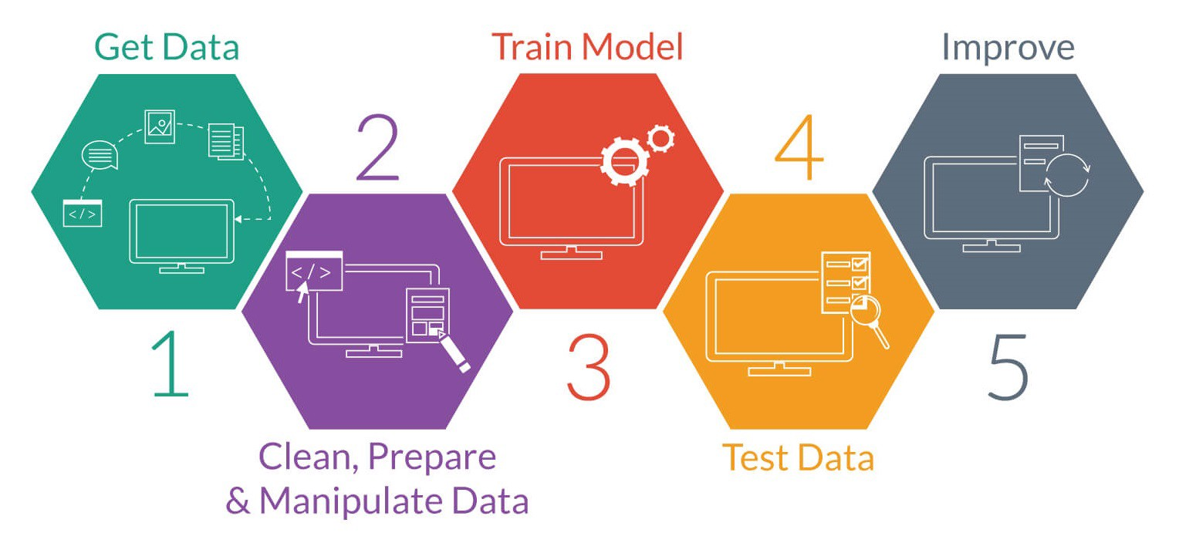
What is Machine Learning
Machine learning is about the construction and study of systems that can learn from data. This is very different than traditional computer programming.

Slide 5
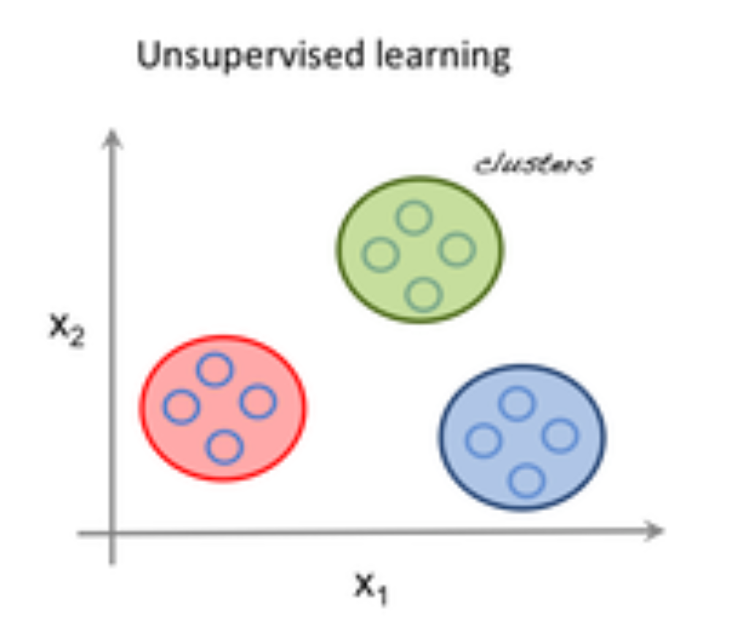
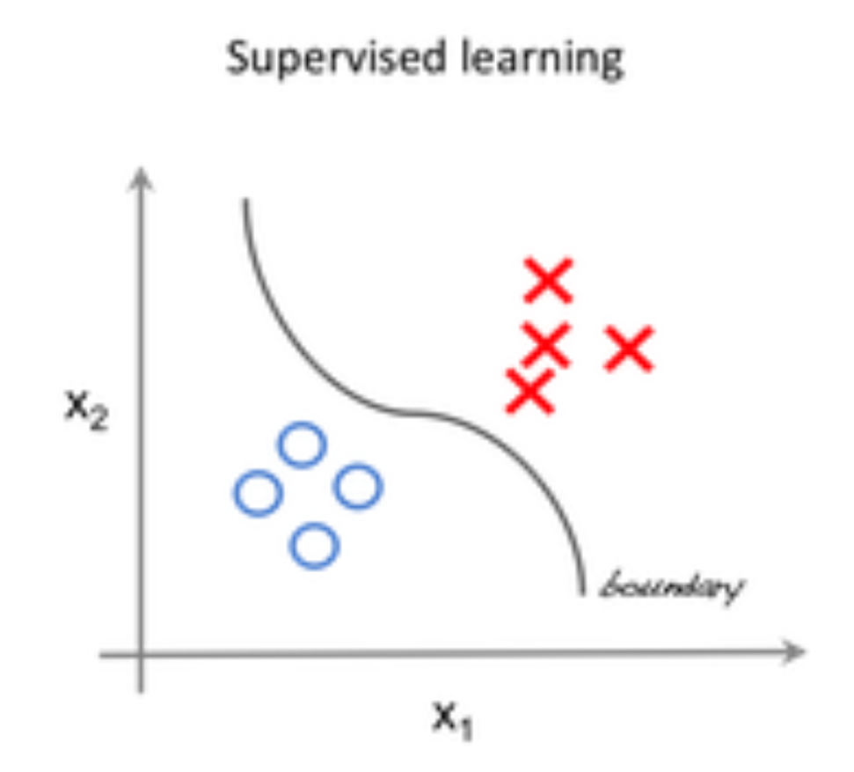
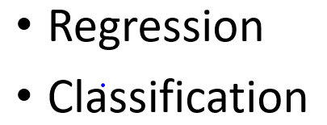
Field of Machine Learning
Supervised learning is one of the methods associated with machine learning which involves allocating labeled data so that a certain pattern or function can be deduced from that data.
Unsupervised learning is the second method of machine learning algorithm where inferences are drawn from unlabeled input data.

Slide 6
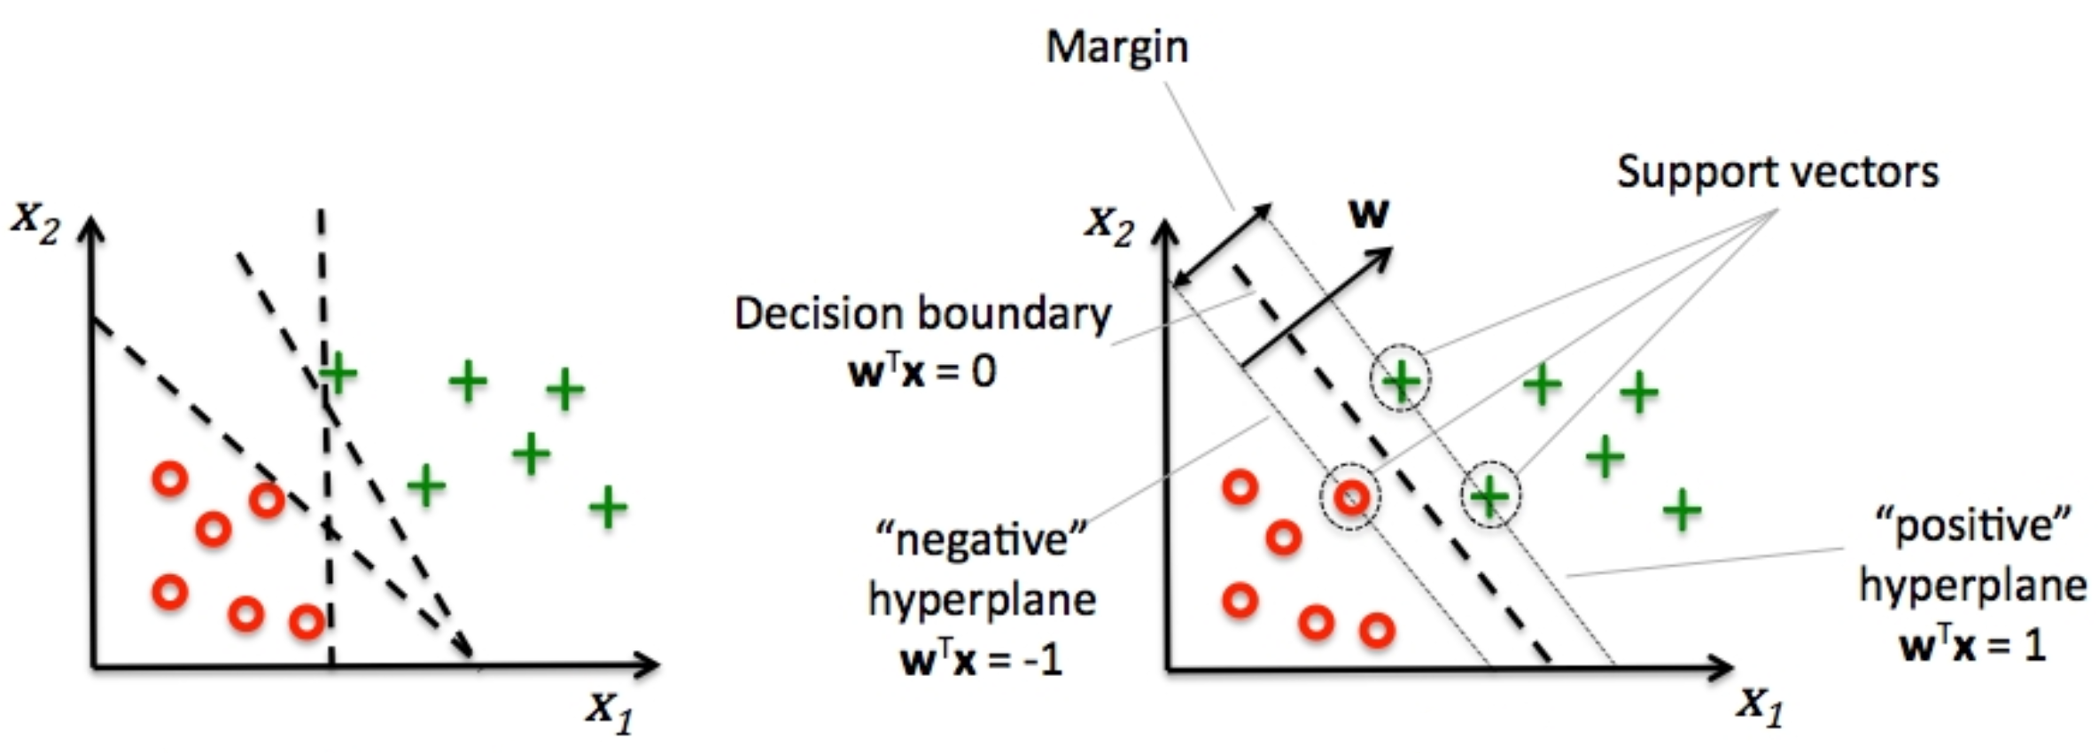
Support Vector Machine:
Classification

Slide 7
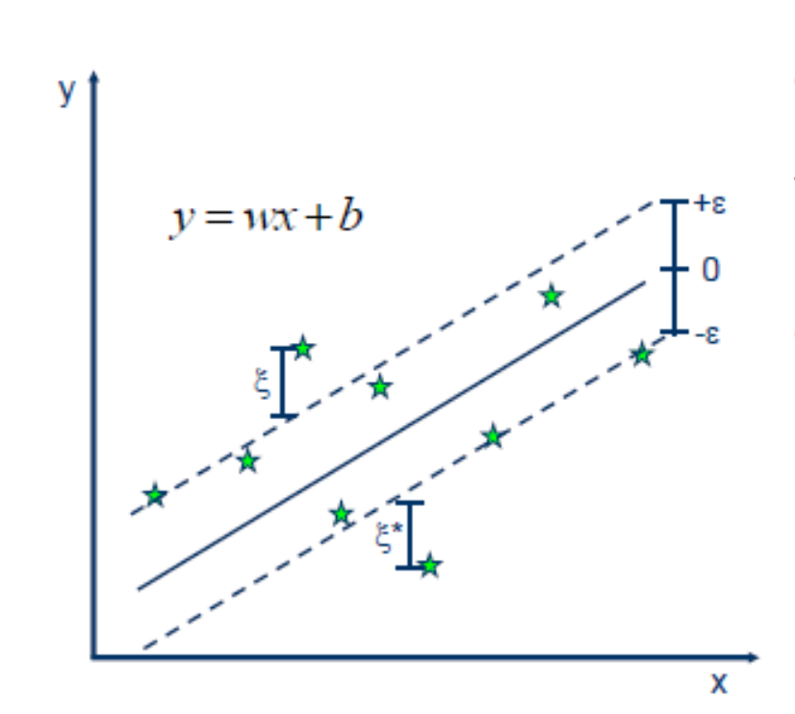
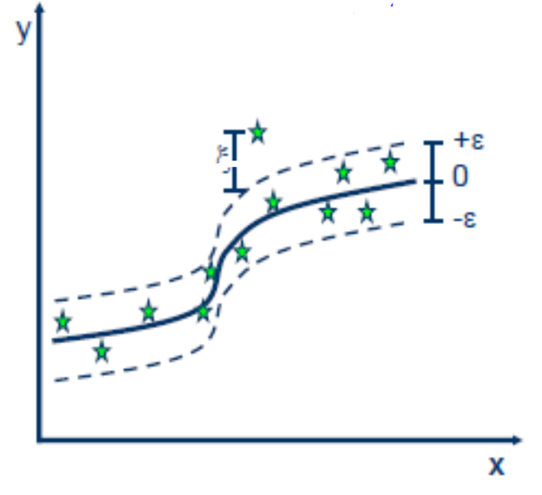
Support Vector Machine:
Regression
Linear Vs Non-Linear

Slide 8
FRCI on Agroforestry (Cidanau)
FRCI calculated using LiDAR data
Remove the outlier using DBSCAN Algorithm
580 Sample data
Feature Selection using Boruta Algorithm
Divide Data (Training and testing data)
K-fold cross validation
Model predicted using SVM

Slide 9
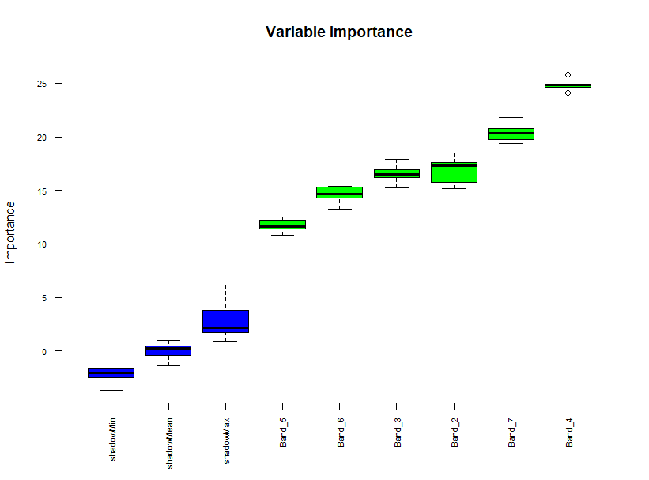
Feature Selection using Boruta Algorithm

Slide 10
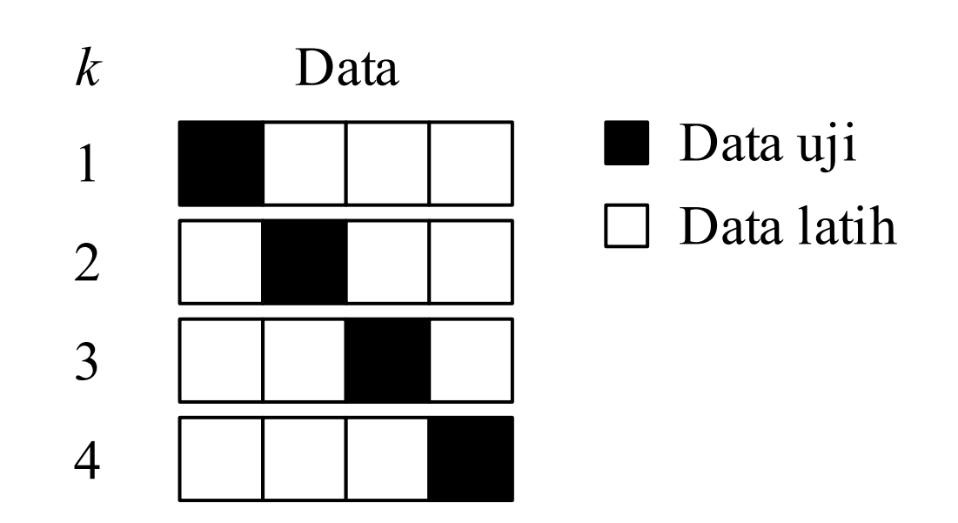
K-Fold Cross Validation

Slide 11
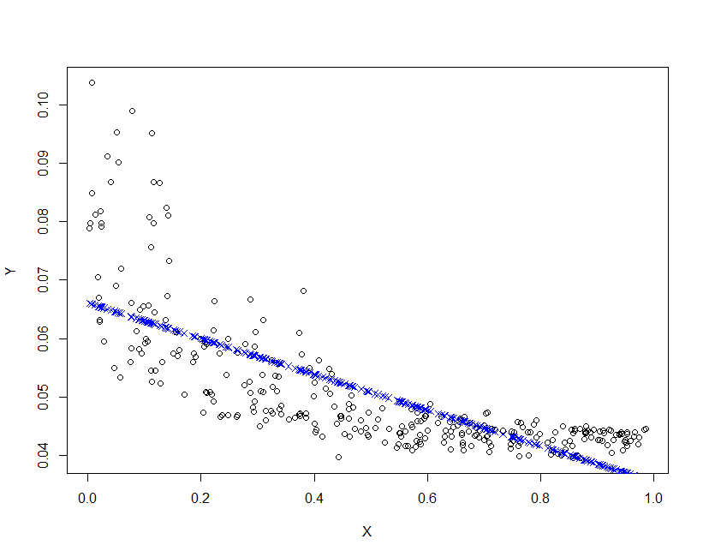
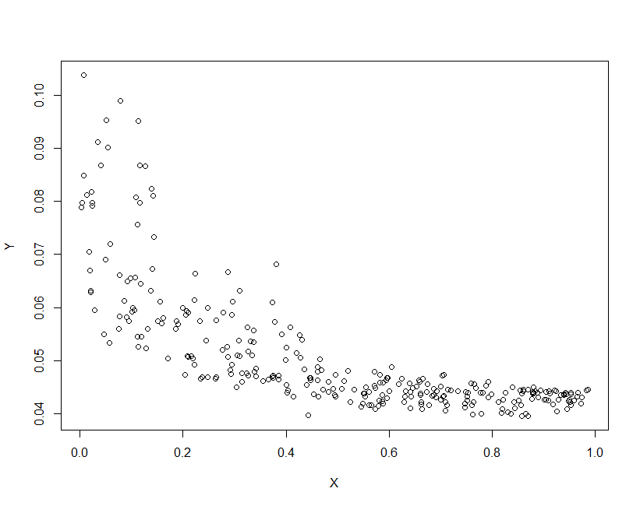
Prediction Model…[1]
Linear Model
RMSE : 0.008028042
FRCI VS Band 4

Slide 12
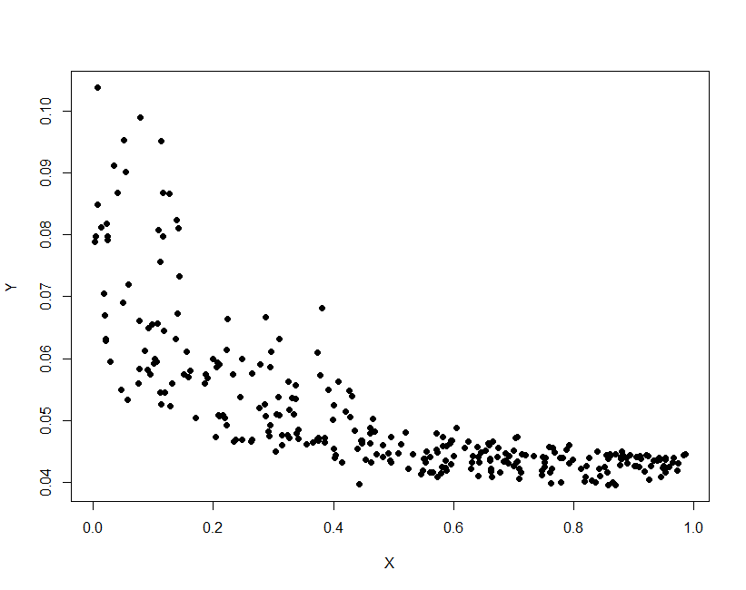
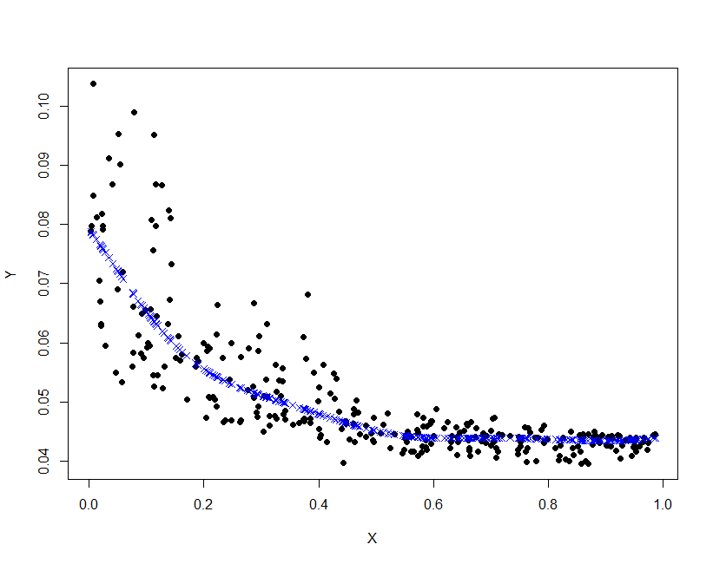
Prediction Model…[2]
SVM
RMSE :0.00645505

Slide 13
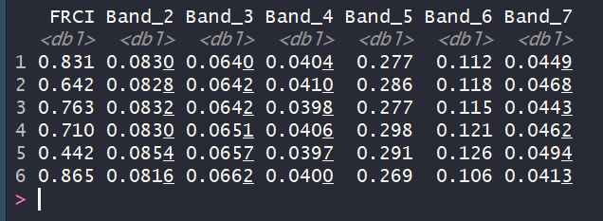
Prediction Model…[3]
SVM
RMSE :0.1188936

Slide 14
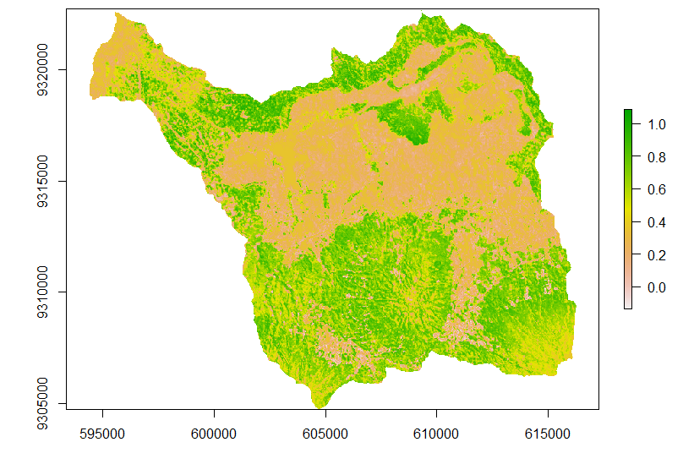
Prediction Map of FRCI

